Slide 1
Outpatient Changes for Contracted Behavioral Health Providers
Prior Authorization Requirement for Community Mental Health Services

Slide 2


Today’s Speaker
Erin Breuleux, LPC
Clinical Program Manager

Slide 3

Today’s Agenda
New changes and requirements
Prior authorization process
Accessing your prior authorization

Slide 4
New Changes and Requirements

Slide 5

New changes and requirements
Why we’re implementing the changes
Create a streamlined process for the providers and UHC Community Plan
Better identify members whose treatment would benefit from a clinical review of the case

Slide 6

New changes and requirements
The new requirements
  Beginning November 1, 2021, United Healthcare Community Plan of Mississippi will begin the online prior authorization process for the following Community Mental Health Services:
  Faxed requests will no longer be accepted
  Level of Care Guidelines: providerexpress.com > our network > State-Specific Provider Information > Mississippi > Level of Care Guidelines
Service | Code
Assertive Community Treatment (ACT) | H0039
Intensive Community Outreach and Recovery Team (ICORT) | H0039 U8
Targeted Case Management/Wraparound | T2023 HW, HT

Slide 7
Prior Authorization Process

Slide 8

Prior authorization process
How we’re implementing the changes
  Beginning November 1, 2021, providers will begin submitting new authorization requests through a portal located on the Provider Express website.
  To access the request form, go to: providerexpress.com > Our Network > State-Specific Provider Information > Mississippi > Authorization Templates
  Portal submissions will be required for both initial and continued stay requests for ACT, ICORT and TCM/Wraparound.
Existing authorizations for these services submitted via fax or telephonically will remain valid until the limits of that authorization have been reached
Notes:
Please note: No log-in is required to submit form.

Slide 9
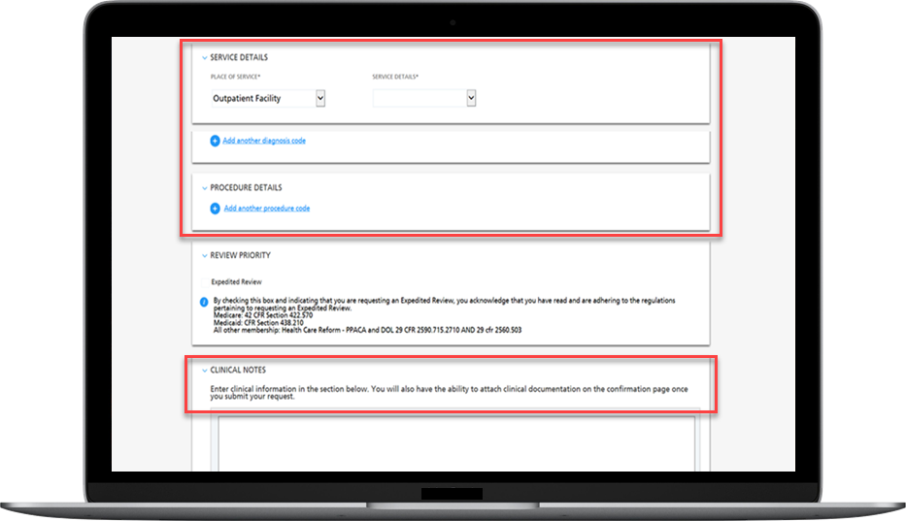
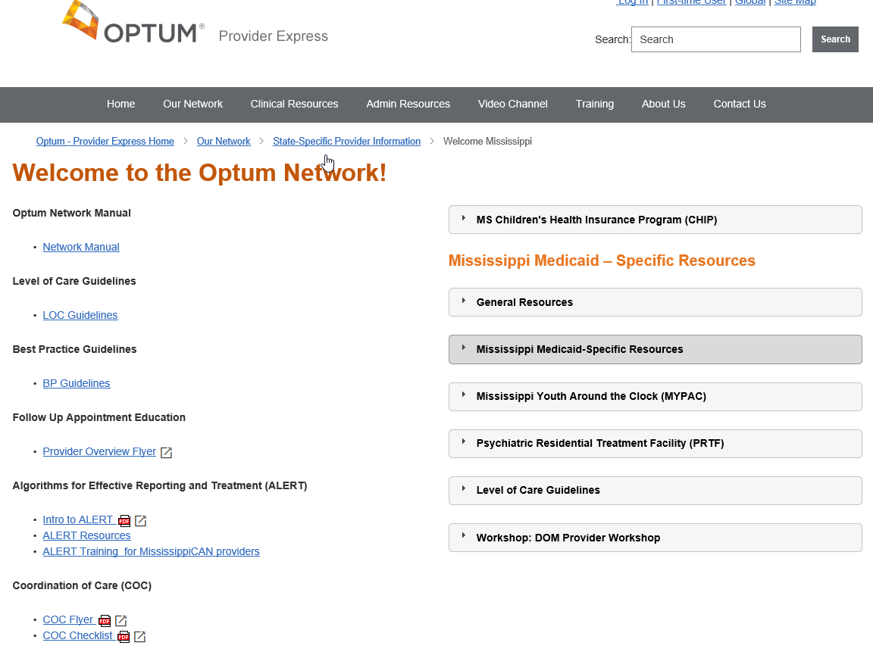
The Mississippi page on Provider Express

Slide 10

Prior authorization process
The submission process
Complete the online request form
Use the “Attesting Individual’s Email Address” to track where request is in the authorization process
If you have checked LINK and have not received a decision within 1 business day from the submission you can contact Provider Services via the Behavioral Health number on the member’s insurance card

Slide 11
Prior authorization process
The review process
  Submission information will be reviewed against our current Adverse Benefit Determination (ABD) information.
    If the service(s) requested has an ABD on file, a Care Advocate will outreach to the provider advising to follow the appeals process
  If services are deemed medically necessary, the member and the care provider will receive written authorization for those services
  If additional information is needed to make an authorization determination, a licensed Care Advocate will outreach the requesting provider for additional or clarifying information
  If medical necessity is in question or the case would benefit from a Psychologist or Medical Director input, the Care Advocate may refer to a peer reviewer
  Live Peer Reviews are not required; providers may request the determination be made based on the information given to the Care Advocate and/or in the online submission

Slide 12
Prior authorization process
The review process continued
An authorization will be created based on the request or final determination
  If a requested service is determined to not meet our level of care guidelines, a letter will be sent including your appeals rights
Once the authorized units are used, requests will be obtained by completing another online submission
Services will be authorized based on our Level of Care Guidelines found on providerexpress.com > Our Network > State-Specific Provider Information > Mississippi

Slide 13
Prior authorization process
Information needed in submitted documentation:
Medical Necessity Reviews will be based on Mississippi Level of Care Guidelines
Current member clinical presentation will be reviewed, including:
  Onset and initial need for the service
  Diagnosis including supporting symptoms and behaviors
  Risk issues including suicidal or homicidal concerns and substance abuse
  Risk plan, if appropriate
  Most recent Higher Level of Care Admission, including ER visit
  Pertinent history of hospitalizations
  Medications including coordination of care with all providers
  Functional impairments and abilities
  Individual Service Plan (ISP)

Slide 14
Prior authorization process
Examples of clinical information being assessed:
Functional Abilities Over Time
Functional Areas | Start of Current Service | Progress (Abilities-Centric) | Goal | Intervention Plan
Work/School Social/Play Family/Relationships Activities of Daily Living Medical/Physical Other | • What strengths/abilities were present when they started treatment? • What gaps/roadblocks/ barriers were interfering with their potential functioning? • Were they having any problems in the area of <functional area>? How often did these occur? • Were there concerns from others around them? • What did the member identify as their abilities and/or concerns? • What are the member’s medical/behavioral comorbidities? | • How have their abilities improved or changed? • How much has this increased or decreased? • How has the progress been? Any set-Backs? • How are they doing now? • Does the member feel like they have made progress? • What has helped them to make this progress? • What types of interventions have worked well? • Are they taking any medications that help? • How do they utilize their support system/community supports? • What types of skills are they learning? | • What do you see as the outcome of this service? • What abilities does the member want to build and strengthen? • What do you anticipate the progress will be going forward? • How long do you anticipate this will take? • What would you and the member need to see to know the member is ready for a reduction in intensity? | • What services are being utilized to meet the member’s goal? • What are the specific skills/interventions being taught/implemented? • How is the member engaging in meaningful activities within the community outside of the home?

Slide 15

Prior authorization process
Length of process:
A decision will be made within 1 business day of the online submission date
Authorization specifics:
  Start date of authorization will be the date of the portal submission or the requested start date if in the immediate future
  Please ensure that your contact information is updated to ensure correct processing of authorization
  Authorization status can be checked using the “recovery email” on the request form link
  Authorization information can be viewed via the Prior Authorization and Notification tile on UHCprovider.com

Slide 16



Staying current with “My Practice Info”
Keeping your information up to date ensures that referrals will find you, and that you get reimbursed promptly and accurately.
Change, and/or modify your address and other demographic information
Indicate your availability to accept new patients into your practice
Let us know if you are going to be away for an extended period-of-time

Slide 17
Accessing Your Prior Authorization

Slide 18
UnitedHealthcare Provider Website
UHCprovider.com
LINK
Prior Authorization and Notification Tool

Slide 19
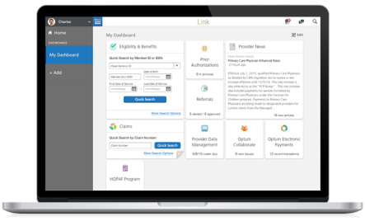
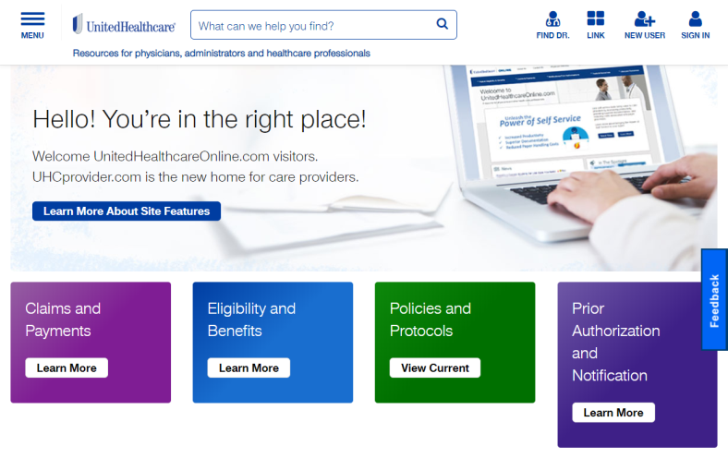
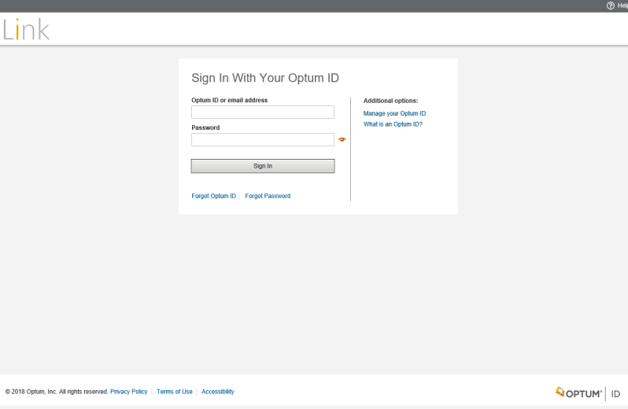
Accessing your prior authorizations online
UHCprovider.com
Link Log-In

Slide 20
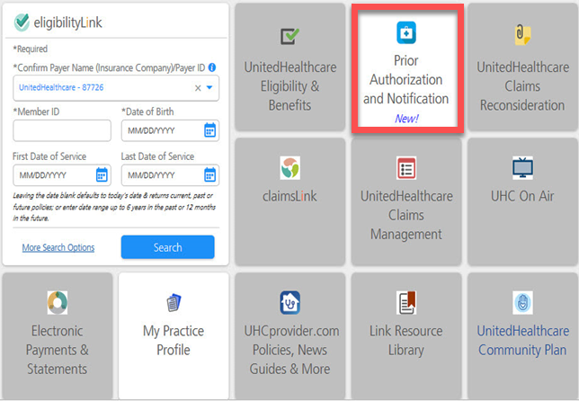
LINK Dashboard

Slide 21
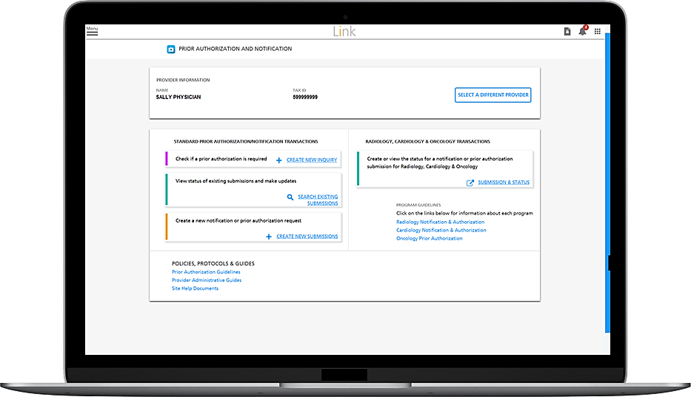
Accessing your prior authorizations

Slide 22
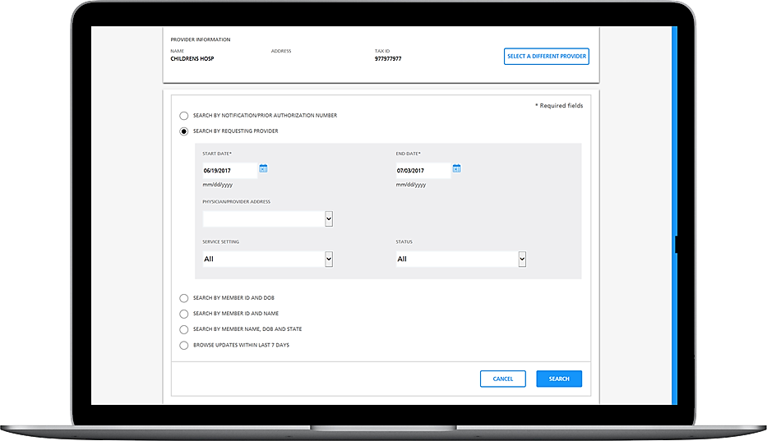
Accessing your prior authorizations cont.

Slide 23
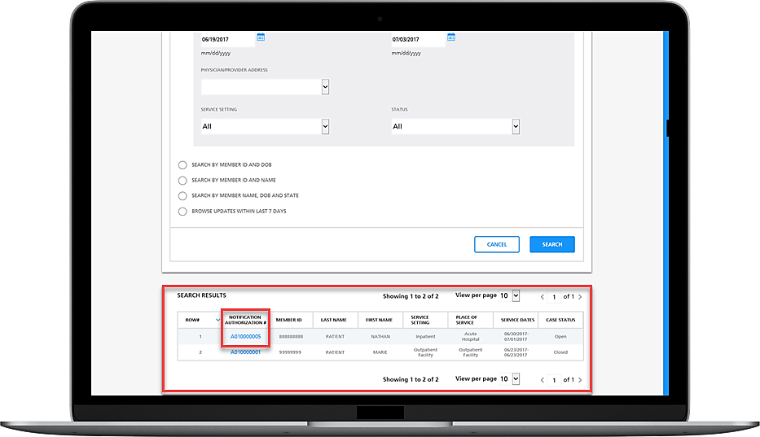
Accessing your prior authorizations cont.

Slide 24
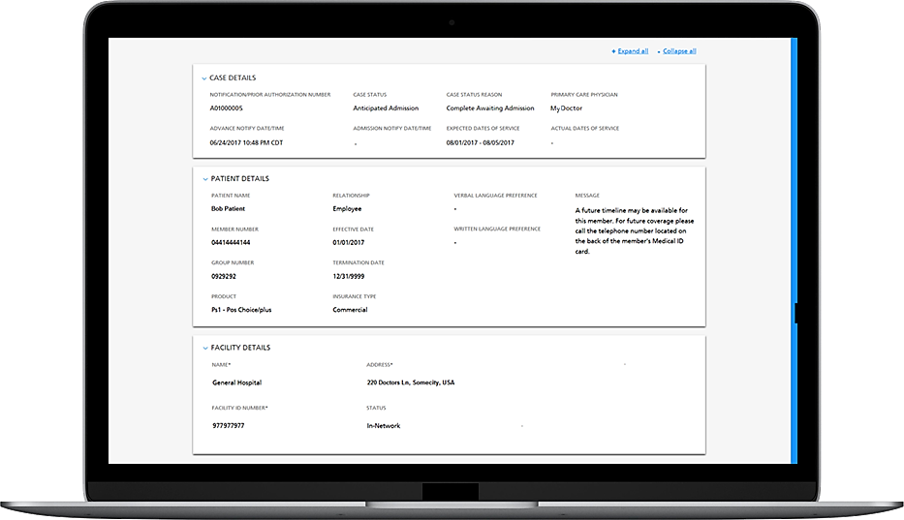
Accessing your prior authorizations cont.

Slide 25
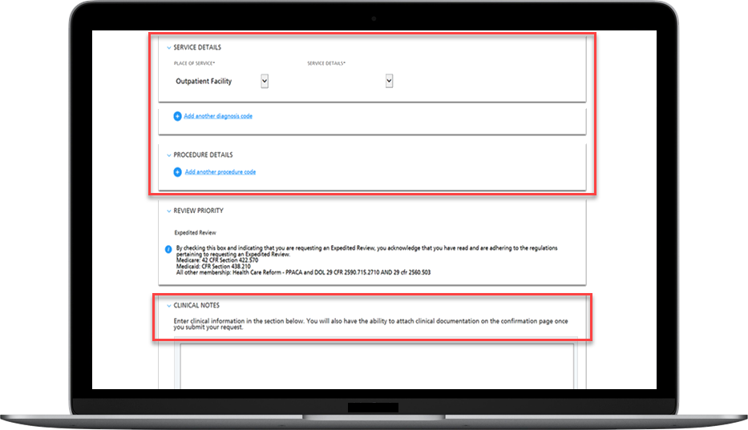
Accessing your prior authorizations cont.

Slide 26
Prior Authorization and Notification Tool Resources
Live training session
UHCprovider.com > Menu > Resource Library > Training > Prior Authorization and Notification Overview
UHC On Air
UHCprovider.com > Menu > Resource Library > UHC On Air
Other training resources
UHCprovider.com > Menu > Prior Authorization and Notification > Prior Authorization and Notification Tool > Quick Reference Guides, Videos and Training Tools

Slide 27
Frequently Asked Questions
Where do I submit my authorization requests for ACT, ICORT and TCM/Wraparound?
  The Mississippi page of Provider Express
  To access the request form, go to: providerexpress.com > Our Network > State Specific Provider Information > Mississippi > Authorization Templates > STEM Outpatient Authorization Form
Where do I check online for my authorizations?
  LINK on UHCprovider.com
  To access the Prior Authorization and Notification Tool go to: UHCprovider.com > LINK > Sign In: With your Optum ID and Password > Prior Authorization and Notification Tool
If I am having trouble viewing my authorization online, who do I contact?
  Technical Assistance: https://www.uhcprovider.com/en/contact-us/technical-assistance.html

Slide 28
Frequently Asked Questions
Is the submission process the same for ACT, ICORT and TCM/Wraparound?
  Yes. Please attach the Assessment and Treatment Plan to each initial and continued stay request
  Please request the authorization within 24-48 hours of initial assessment

Slide 29
Erin Breuleux
Thank you
Clinical Program Manager

